Slide 1
An Introduction to the SOA
July 2019

Slide 2
Over 31,811 Members worldwide
44,282+ Candidates
3,800+ Volunteers
Three-fold commitment:
Education, Research and the Profession

Slide 3
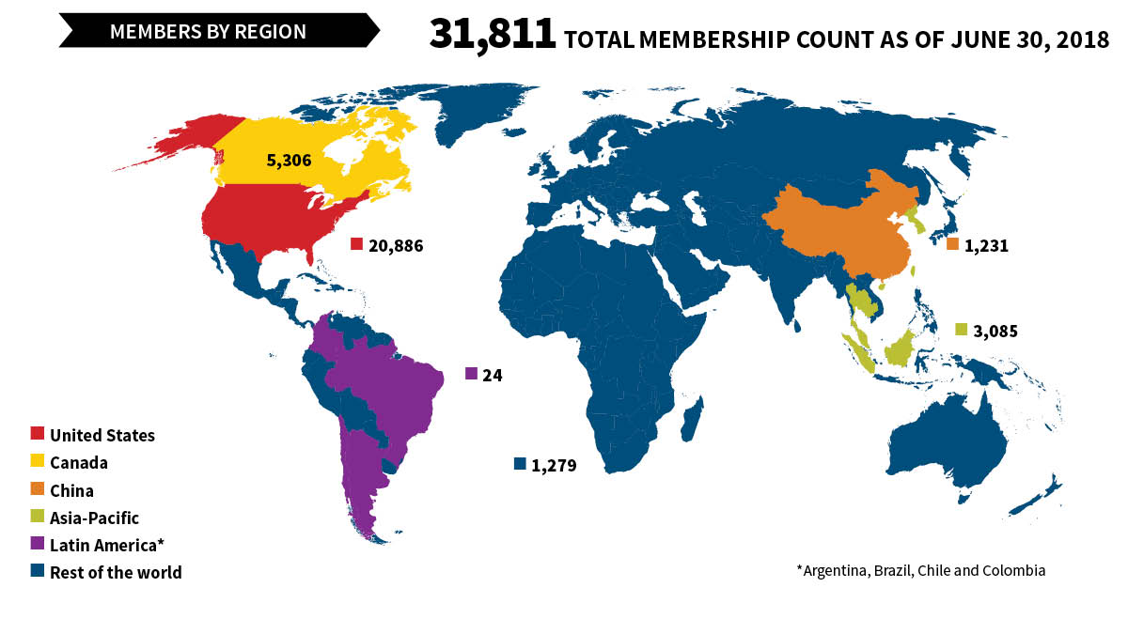
SOA Membership Overview

Slide 4
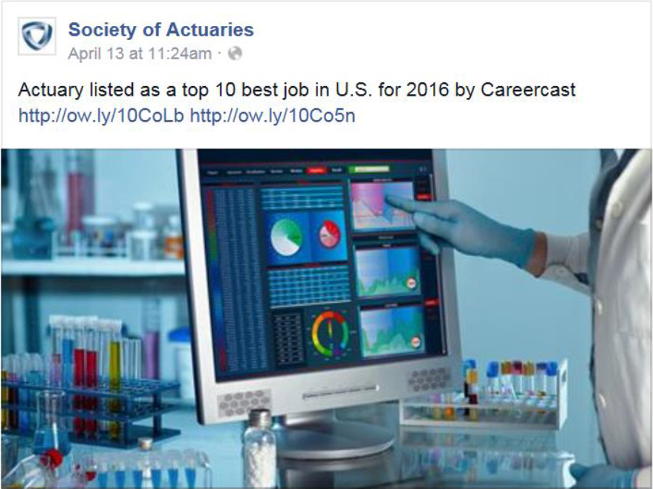
Top Ranking Job in the USA
Notes:
4

Slide 5
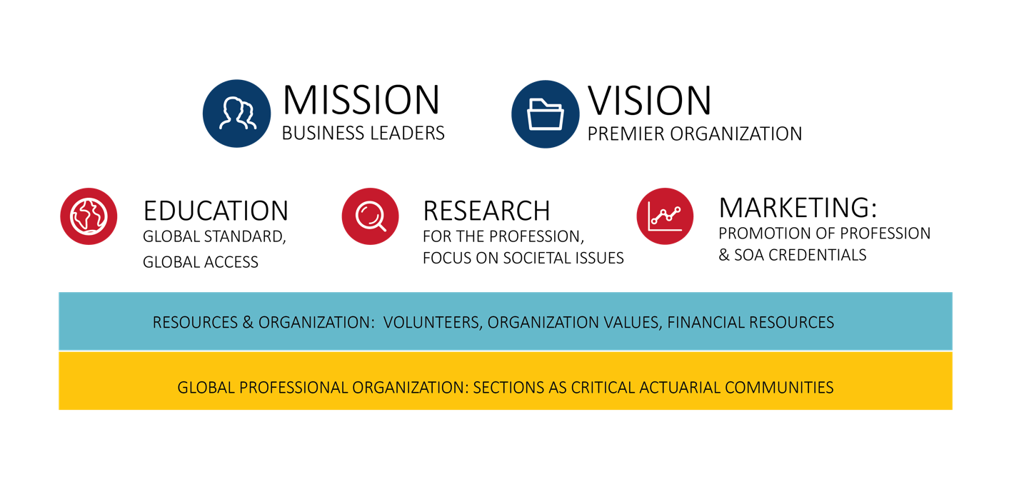
Our Strategic Vision

Slide 6
Educating Actuaries. Advancing the Profession. Impacting Society.

Slide 7
SOA Research Programs

Slide 8
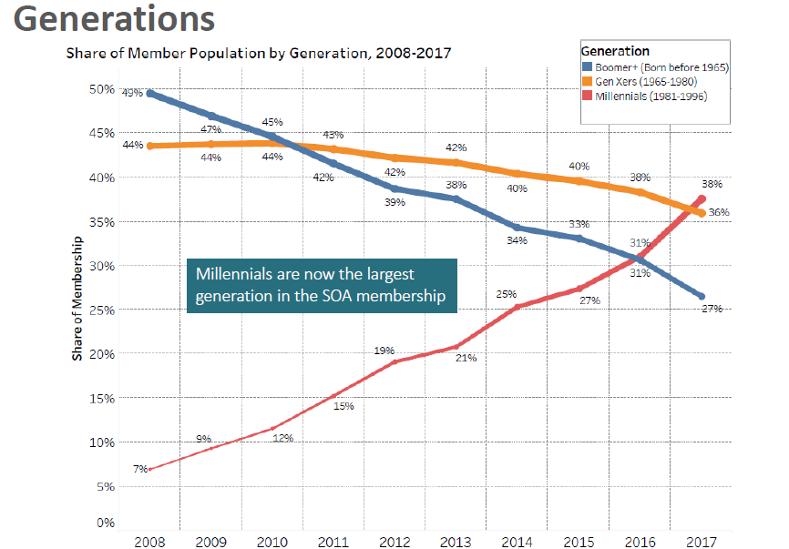
Generations
Share of Member Population by Generation, 2008 – 2017

Slide 9
Latin America

Slide 10
Latin America Committee
OBJECTIVES
Increase the awareness of the SOA in Latin America,
Collaborate to improve the skills of actuaries and the actuarial profession,
Enhance the reputation and visibility of the profession,
Build relationships with regulators, universities, local associations and employers, and
Broaden the influence and effectiveness of actuaries in the region.
FOCUS
Argentina, Brasil, Chile and Colombia

Slide 11
Universal Life Presentation - 2018
23%
Individual Life

Slide 12
IFRS 17 & Solvency II Workshop
Ronald Poon Affat FSA FIA MAAA CFA
Brazil CEO
July, 2019

Slide 13
I read the news today.. oh boy!
Moodys Analytics

Slide 14
What is IFRS 17
PWC IFRS17 Insurance contracts

Slide 15
On your marks, get set.. Goooooo!
Moodys Analytics

Slide 16
What are the objectives of IFRS17?
To ensure that an entity provides relevant information that faithfully represents rights and obligations from insurance contracts it issues
To eliminate inconsistencies and weaknesses in existing accounting practices
Provide a single principle based framework to account for all types of insurance contracts including reinsurance contracts
To enhance global comparability between insurers
To enhance comparability with other industries
Transparency and understandability

Slide 17
Who has adopted IFRS17?
According to the IASB, at present there are 166 countries substantially on IFRS, 22 countries who are not.
Fifteen of the G20 jurisdictions have adopted IFRS Standards for all or most publicly traded companies and also permit IFRS Standards for all or most non-publicly traded companies.
Of the five who have not adopted, China, India and Indonesia have adopted national standards that are substantially in line with IFRS Standards but have not announced a timetable for full adoption.
Japan permits IFRS Standards on a voluntary basis for domestic companies.
The United States does not permit domestic securities issuers to use IFRS Standards but it does permit foreign securities issuers to use IFRS Standards

Slide 18
What might a CEO ask a IFRS17 manager in the elevator?
Where are our competitors in their roll outs
Where are companies spending their budgets
What`s keeping you up at night?

Slide 20
CEO Q&A
Where are companies investing their IFRS17 budgets
IT – shift from in-house positions to external consultants
The calculation engine. Getting the model right
Data Management – preparing data hubs
Streamlining of current reporting practices
What are some of the greatest concerns
Treatment of ‘grey areas’ e.g reinsurance, transition,
Ability to join up Actuarial, Accounting and IT processes
Fear that it will turn into a ‘rush job’
Finish with enough time to allow for ‘unforeseen issues’
HR issues
Managing talent
Ensure knowledge transfer between consultants & permanent staff
Interview with Meller, Beukes, Edvardsen

Slide 21
Additional food for thought..
What are the most challenging aspects of an IFRS 17 implementation?
How can I get my company up to speed on IFRS 17 issues?
Should we purchase an IFRS 17 calculation engine, or should we develop it internally?
Can a Solvency II balance sheet be used for IFRS 17 purposes?
What are the differences between the risk adjustment (IFRS 17) and the risk margin (Solvency II)?
How to prioritize my plan of action

Slide 22
Additional food for thought..
What are the most challenging aspects of an IFRS 17 implementation?
How can I get my company up to speed on IFRS 17 issues?
Should we purchase an IFRS 17 calculation engine, or should we develop it internally?
Can a Solvency II balance sheet be used for IFRS 17 purposes?
What are the differences between the risk adjustment (IFRS 17) and the risk margin (Solvency II)?
How to prioritize my plan of action

Slide 23
Closing thoughts..
This is not just a change in accounting.
The metrics by which we measure success and sources of profit are going to change
Regulators are going to have to change capital frameworks and tax authorities will be revising their tax regimes
Business models and decision making are going to be impacted.
Actuaries have the `opportunity` to be the `go to` advisers to C-Suite going forward

Slide 24
Thought leadership

Slide 25
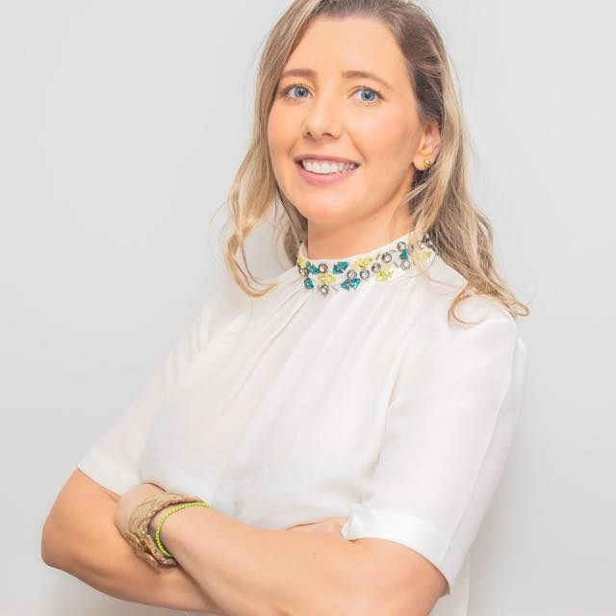
Máris Caroline Gosmann MSc, MBA, MIBA
Associate Professor of Federal University of Rio Grande do Sul (UFRGS)
Máris has been lectured in Actuarial science lecturer for over 10 years. Currently, she is preparing a PhD thesis on IFRS 17 at the Federal University of Rio de Janeiro in the Accounting Department.
Her qualifications include an Actuarial Science degree at UFRGS, a degree in Economics, Specialization in Economics & Finance and a Master's Degree in Actuarial Studies at PUC-Rio.
Máris is originally from Rio Grande do Sul but is an aspiring carioca. In her spare time she practices jiu-jitsu and self defense; this training is also useful to keep her three children `in line`

Slide 26
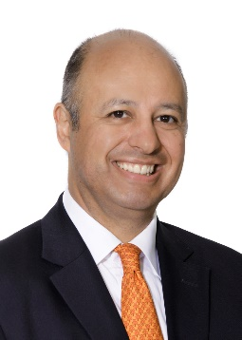
Carlos Arocha FSA
Managing Partner, Arocha & Associates (Switzerland)
Carlos leads a team that provides advisory services related to IFRS 17 implementation projects, Solvency II risk models and governance, and appointed actuary mandates
He received his Actuarial Science degree at Anahuac University, in Mexico City. He is qualified as Mexican actuary, and is a Fellow of the Society of Actuaries. Carlos is a recipient of the 2018 SOA Outstanding Volunteer Award
Carlos teaches a distance-learning class on Integrated Projects at the Master of Actuarial Science Program, Columbia University, New York
Carlos lives in Zurich since 1997. He is an avid chess player and also plays non-competitive tennis

Slide 27
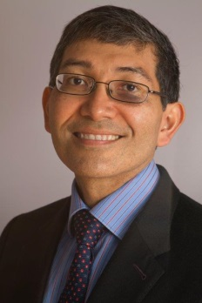
Ronald L Poon-Affat FSA, FIA, MAAA, CFA
CEO RGA Brazil
He is responsible for leading a Sao Paulo based team to offer risk transfer solutions to Brazilian & Caribbean clients
Based in Brazil since 1997, Ronald’s 33 years of experience encompasses both developed and emerging markets countries in South America, the Caribbean and Europe. Before coming to RGA, he led reinsurance teams in Latin America for Munich Re and Gen Re Life & Health. He also was CFO of Icatu-Hartford, Brazil and CRO of the São Paulo, Brazil-based health conglomerate Tempo Assist.
Ronald received his Actuarial Science degree at the University of London, UK. He is qualified as a British actuary, a Member of the American Academy of Actuaries (MAAA), a Chartered Financial Analyst (CFA) and a Fellow of the Society of Actuaries (FSA. He is a recipient of both the SOA Outstanding Volunteer (2015) and Presidential award (2016)
To date Ronald has competed in 13 marathons and has already run 1,600km during 2019.

Slide 28
©2017 RGA. All rights reserved.
No part of this publication may be reproduced in any form without the prior permission of RGA.
The information in this publication is for the exclusive, internal use of the recipient and may not be relied upon by any other party other than the recipient and its affiliates, or published, quoted or disseminated to any party other than the recipient without the prior written consent of RGA.

